Slide 1
Installing Redis Enterprise & setting replicaof Redis 3.0.7 Open-source

Slide 2
Problem Statement
Replica-of
Install standalone Open Source Redis version 3.0.7 on Server A.
Make sure you change the default port from 6379 to something else in the redis.conf file.
Use memtier-benchmark tool created by Redis, to load data into the standalone Redis.
Install Redis Enterprise GA version on Server B.
Setup Redis Enterprise using no DNS option.
Create a Redis DB on Redis Enterprise.
Enable “Replica Of” between the Redis Enterprise DB and the Open Source Redis. (Source: OpenSource Redis, Target: Redis Enterprise DB).
Please send an email with some details on how it is going so far.

Slide 3
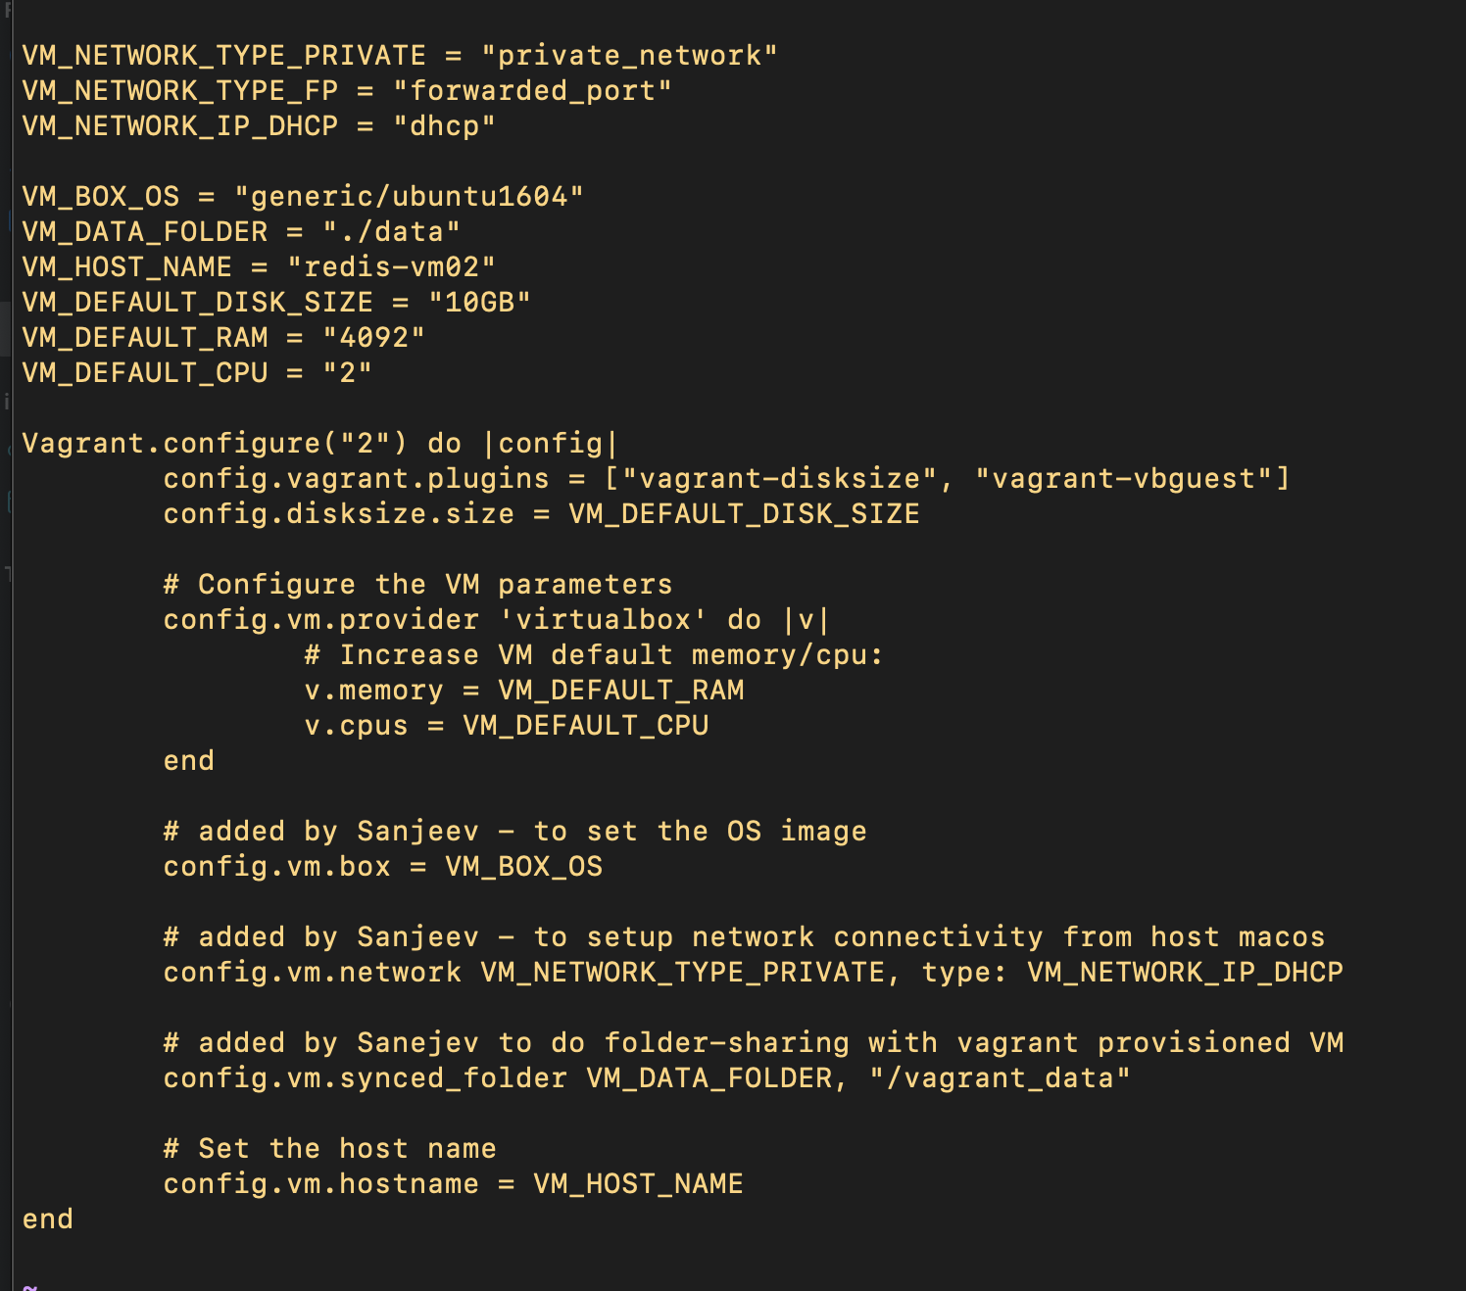
Setup Server-A (Redis 3.0.7 Open Source)
Vagrant VM as SERVER-A (Referred as redis-vm02)
(for hosting redis open source 3.0.7 – Vagrant script attached)
Operating System = "generic/ubuntu1604"
Shared folder = "./data"
Host-Name = "redis-vm02"
Disk-size = "10GB"
RAM = "4092"
CPU = "2"
Redis 3.0.7 Installation Instructions - https://www.digitalocean.com/community/tutorials/how-to-install-and-configure-redis-on-ubuntu-16-04

Slide 4
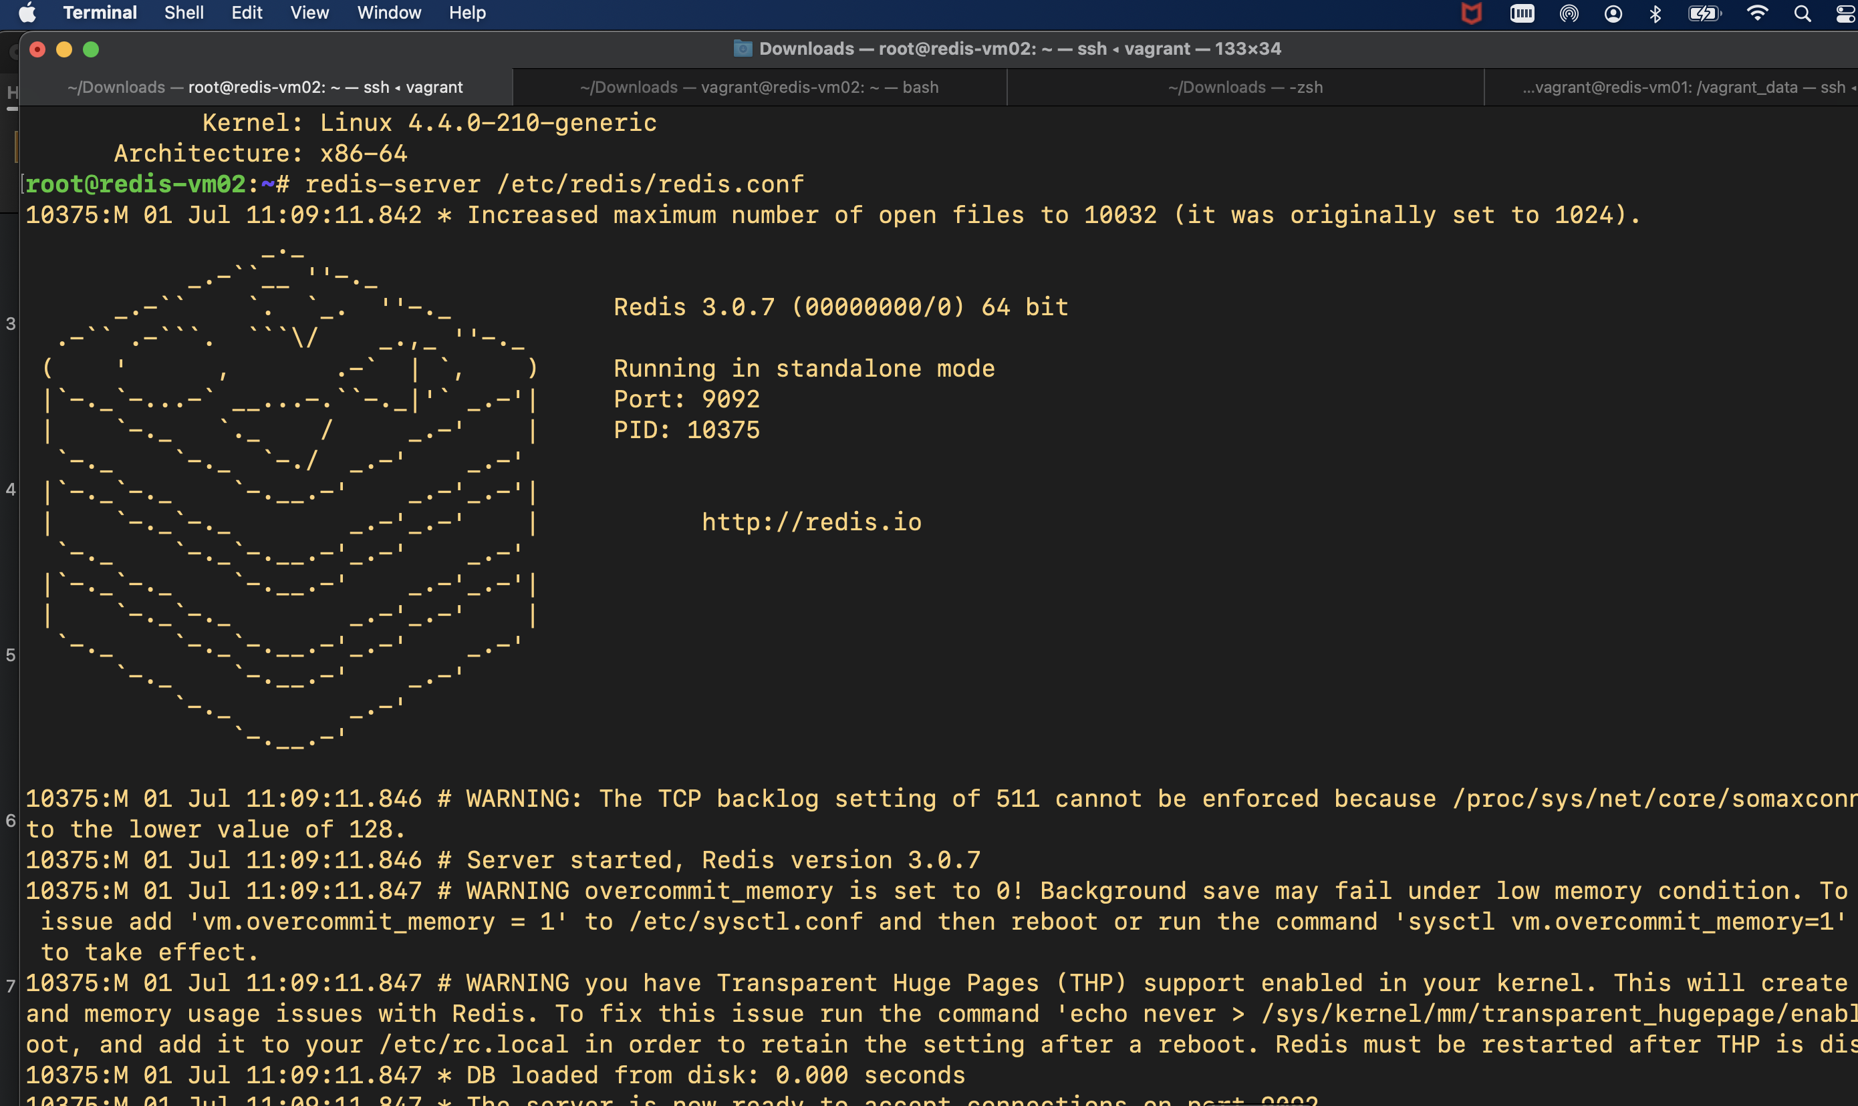
Setup Server-A (Redis 3.0.7 Open Source)

Slide 5

Setup Server-B (Redis Enterprise Server)
Vagrant VM as SERVER-B (Referred as redis-vm02)
(for hosting redis enterprise server– Vagrant script attached)
Operating System = "generic/ubuntu1604"
Shared folder = "./data"
Host-Name = "redis-vm01"
Disk-size = "10GB"
RAM = "4092"
CPU = "2"
Redis enterprise Server Installation Instructions - https://docs.redis.com/latest/rs/installing-upgrading/
Note: The deployment doesn’t use systemd-resolved (DNS server) driven addressing. Instead, the solution makes use of IP address based addressing for establishing the replicaof settings
Redis-tools
https://stackoverflow.com/questions/21795340/linux-install-redis-cli-only

Slide 6
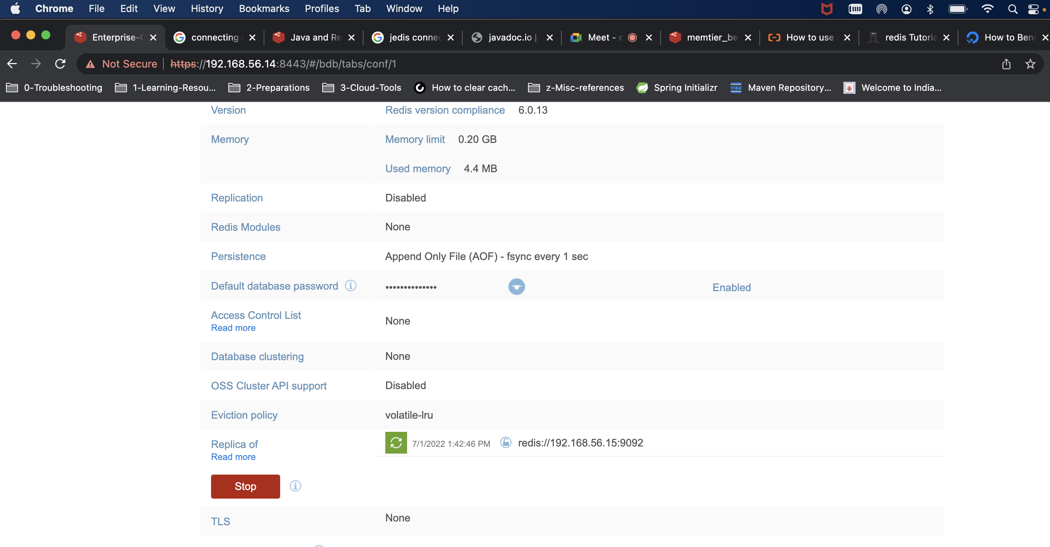
Setup replicaof Redis 3.0.7 Open source Server
Reference links - https://docs.redis.com/latest/rs/concepts/compatibility/
https://medium.com/@octoz/high-availability-and-scalability-with-redis-enterprise-54a48edcce17

Slide 7
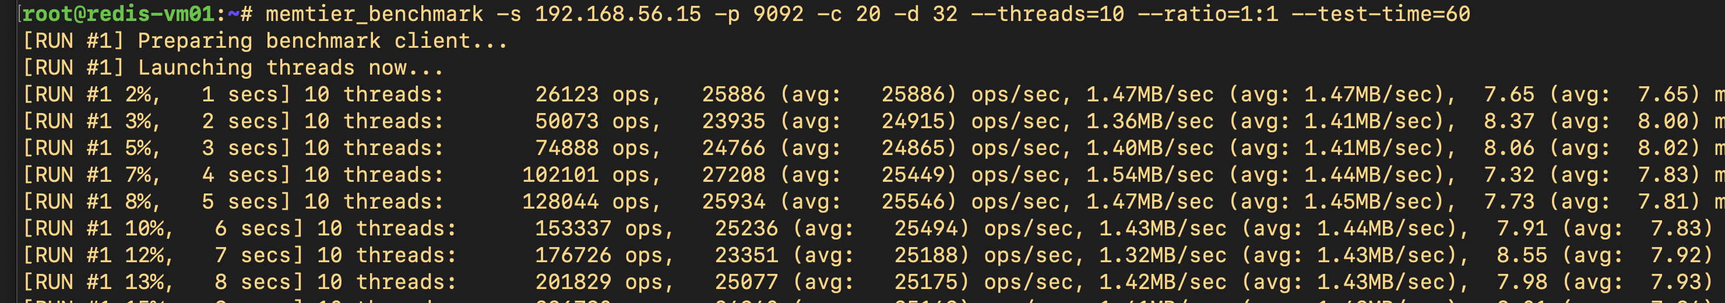
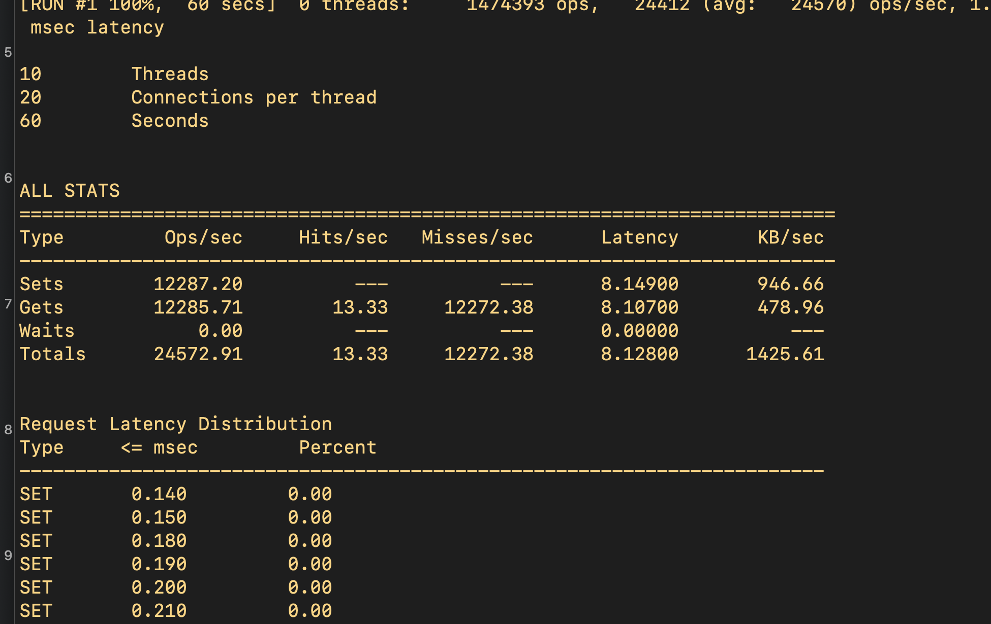
Loading Data to Stand-alone Redis Server (Server-A) using memtier_benchmark tool

Slide 8
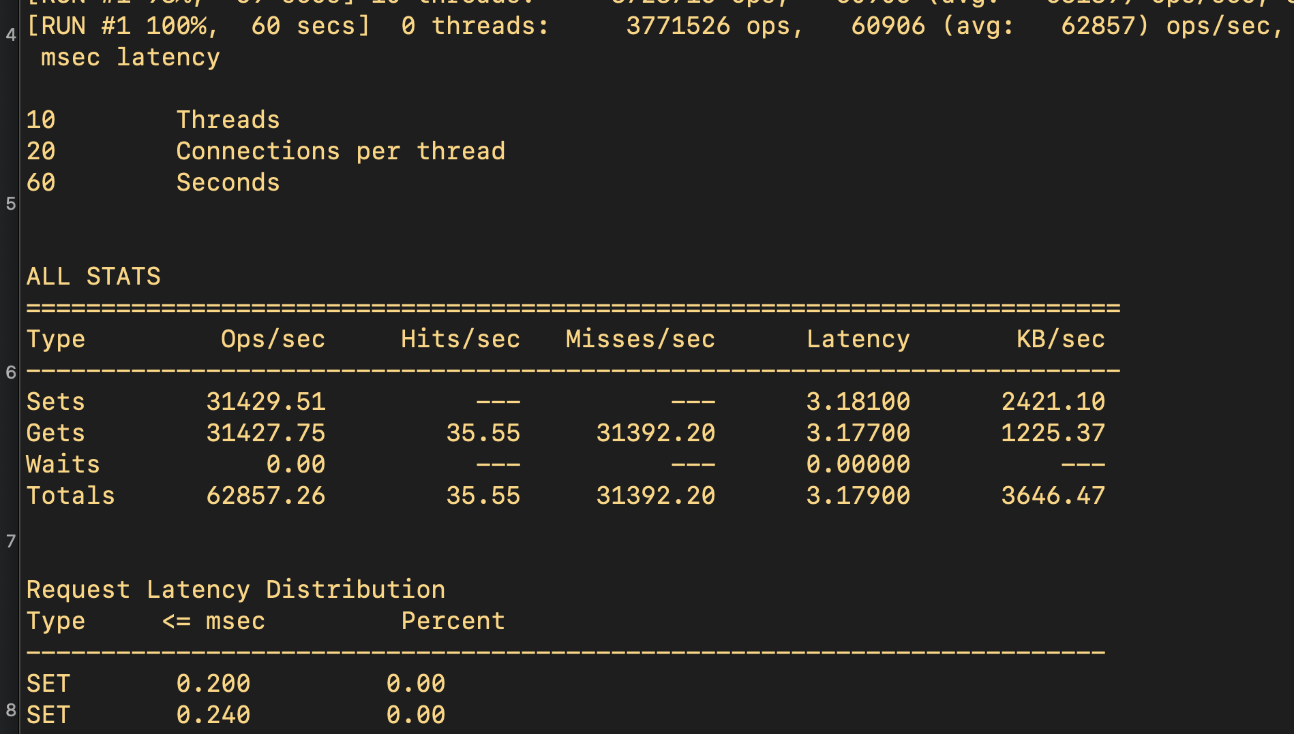
Loading Data to Redis Enterprise Server (Server-B) using memtier_benchmark tool

Slide 9
Application Walkthrough

Slide 10
Problem Statement
Application
Choose a coding language to implement this using the appropriate Redis Data Type:
Insert the values 1-100 to the Redis OSS server
Extract them in reverse order from the Redis Enterprise DB resource.
For validation: preserve the output of steps 1 & 2.

Slide 11
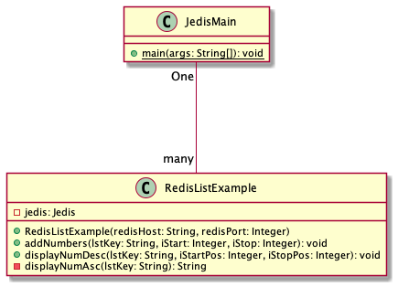
Solution Approach
Programming Tools
Programming Language: Java
Project Type: Maven
IDE : Eclipse
Redis Client Lib: Jedis
Pre-requisites
Redis source server is up & running (Open-Source Instance)
Redis destination server is up & running (Enterprise Server Instance)
The Enterprise Server is configured as replicaof redis open-source server instance

Slide 12
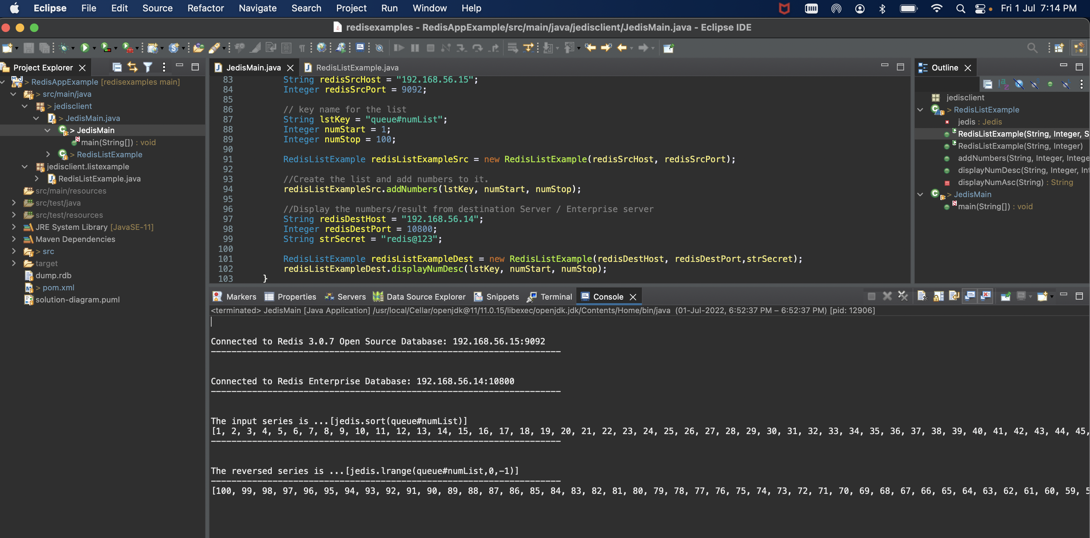
Application Outputs

Slide 13
Solution Walkthrough

Slide 14
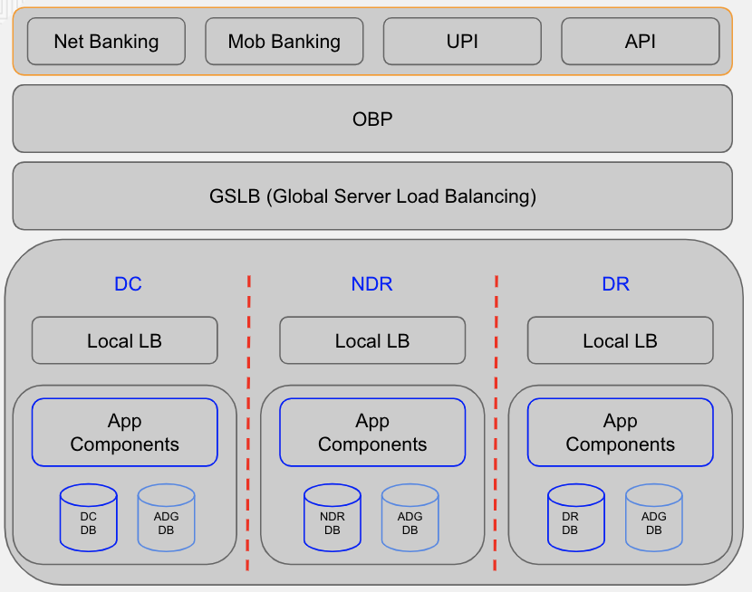
Problem Statement
One of the largest banking customers was looking to optimise their core-banking deployments by segregating the enquiry loads from regular banking transactions initiated via various channels like UPI, net-banking, mobile banking or API channels. The following points illustrate the deployed architecture along with key objectives for the solution -
CBS was hosted across three isolated sites- 2 in Mumbai (DC & NDR) and one in Bangalore (DR).
Each of the sites had their own database instances and were self-sufficient to functions as CBS instances. At any given point in time, Only one site remains active for accepting the transactions (enquiry + update).
The transactions (Enquiry + Update) initiated via various channels – net-banking, mobile banking, UPI or other sources land onto the global load balancer that forwards the same to one of the underlying sites - Primary DC, NDR or DR – whichever is active.
All the three sites are synchronised using the real-time replication (Oracle Data Guard) implementation.
The databases for all non-active sites were the read-replica of production sites and can not accept “update” transactions - due to this, the production sites can not be offloaded from enquiry transactions since the enquiry transactions also require CRUD operations related to maintaining of the audit trail records.
The volume of Enquiry transactions is approx 5000 TPS and is expected to grow massively (48000 TPS) in near future.
As-Is Architecture

Slide 15
Solution Architecture
UPI
Net-Banking
Key Features
Provisions to offload the production site from Enquiry transactions and making it more available to process to other complex transactions.
Zero data-loss – high reliability and distributed solution with redis streams.
Provisions for role-reversals. Externalised configurations for request Broker.
Ability to deal with growing volumes of enquiry transactions
Mobile Banking
API
GSLB
Config
DC Site (Active)
NDR Site
DR Site
Local Load Balancer
Local Load Balancer
Local Load Balancer
Request Broker (HA)
Request Broker (HA)
Request Broker (HA)
Redis Streams
Redis Streams
Redis Streams
CBS App Components
Consumer
Groups
CBS App Components
Consumer
Groups
Consumer
Groups
CBS App Components
DC
ADG
DC
ADG
DC
ADG
Replication Infrastructure

Slide 16
Solution Architecture
UPI
Net-Banking
Key Features
Provisions to offload the production site from Enquiry transactions and making it more available to process to other complex transactions.
Zero data-loss – high reliability and distributed solution with redis streams.
Provisions for role-reversals. Externalised configurations for request Broker.
Optimised Performance powered by Redis Cache
Ability to deal with growing volumes of enquiry transactions
Mobile Banking
API
GSLB
Config
DC Site (Active)
NDR Site
DR Site
Local Load Balancer
Local Load Balancer
Local Load Balancer
Request Broker (HA)
Request Broker (HA)
Request Broker (HA)
Redis Streams
Redis Streams
Redis Streams
CBS App Components
Consumer
Groups
CBS App Components
Consumer
Groups
CBS App Components
Consumer
Groups
Redis Cache
Redis Cache
Redis Cache
DC
ADG
DC
ADG
DC
ADG
Replication Infrastructure

Slide 17
Solution Architecture
Request Brokers (HA)
Consumer Groups
Redis Streams
DB Replications
Java based application
Ability to detect the active site based on configurations
On active nodes, acts as request forwarder for enquiry request to non-active instances.
On non-active instances, produces the audit trail records to redis streams and serves the query
Consumer groups are responsible for updating the database with audit logs for the enquiry transaction
Remain active on active instance
Do not process the streams produced by local request broker.
Vehicle for routing audit trail updates to primary instance
Local deployment for each site
Capturing of record metadata that can be pushed for analytics requirements
Data Replications with min latency for real-time synchronizations.
Local redis cache instance can be introduced to eliminate the need for eventually consistent databases for real-time experience with enquiry operations

Slide 18
Thank You

